Slide 1


Artificial Intelligence
Session 4:
Constraint Satisfaction Problems
School of Computing and Engineering
University of West London, UK
Dr Massoud Zolgharni

Slide 2

Constraint Satisfaction Problems

Slide 3

What is Search For?
Assumptions about the world: a single agent, deterministic actions, fully observed state, discrete state space
Planning: sequences of actions
The path to the goal is the important thing
Paths have various costs, depths
Heuristics give problem-specific guidance
Identification: assignments to variables
The goal itself is important, not the path
All paths at the same depth (for some formulations)
CSPs are a specialized class of identification problems

Slide 4
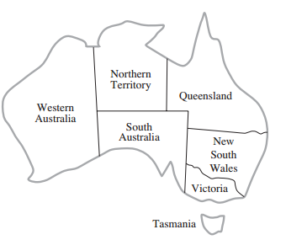
CSP Example – Map Colouring

Slide 5


Constraint Satisfaction Problems
Standard search problems:
State is a “black box”: arbitrary data structure
Goal test can be any function over states
Successor function can also be anything
Constraint satisfaction problems (CSPs):
A special subset of search problems
State is defined by variables X_{i} with values from a domain D (sometimes D depends on i)
Goal test is a set of constraints specifying allowable combinations of values for subsets of variables

Slide 6


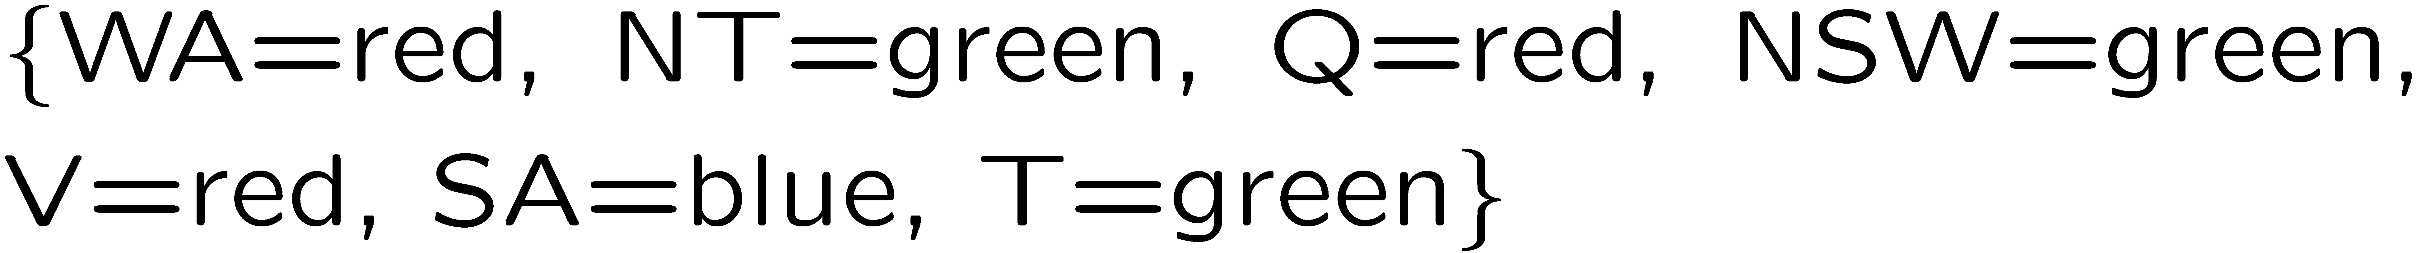
Map Colouring
Variables:
Domains:
Constraints: adjacent regions must have different colours
Solutions are assignments satisfying all constraints, e.g.:
Implicit:
Explicit:

Slide 7
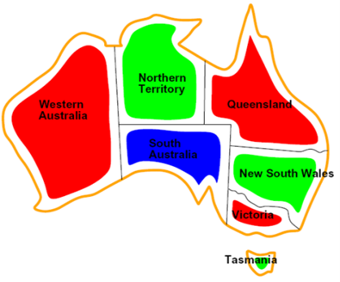
Constraint Graphs
Constraint graph: Nodes are variables, arcs are constraints

Slide 8

Varieties of Constraints

Slide 9

Varieties of constraints
Unary constraints involve a single variable
e.g., SA ≠ green
Binary constraints: each constraint relates pair of variables
e.g., SA ≠ WA
Binary constraint graph: nodes are variables, arcs show constraints
Higher-order constraints involve 3 or more variables

Slide 10
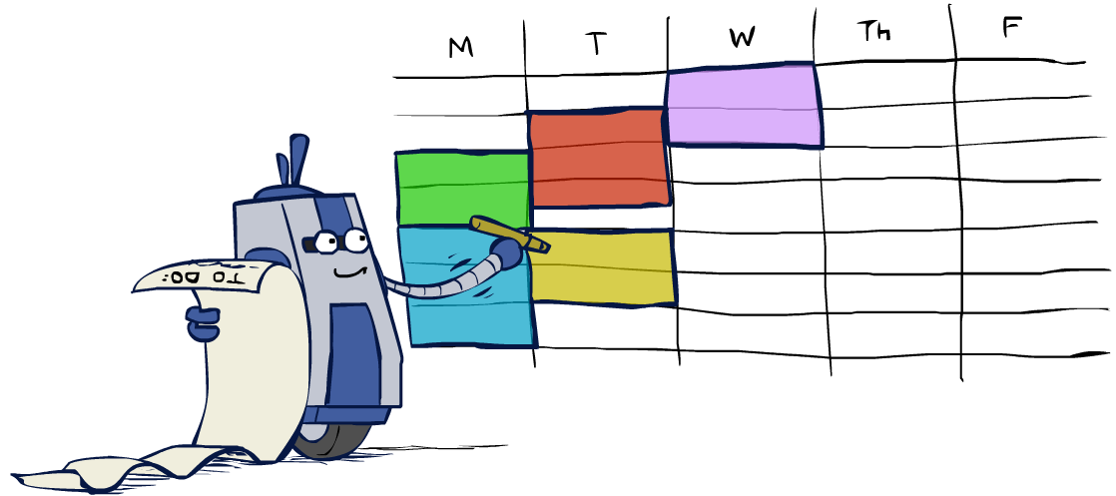
Real world CSPs
Scheduling problems: e.g., when can we all meet?
Timetabling problems: e.g., which class is offered when and where?
Assignment problems: e.g., who teaches what class
Hardware configuration
Transportation scheduling
Factory scheduling
Circuit layout
Fault diagnosis
… lots more!
Many real-world problems involve real-valued variables…

Slide 11

Solving CSPs

Slide 12
Standard Search Approach
Start with the straightforward, naïve approach
States defined by the values assigned so far (partial assignments)
Initial state: the empty assignment, {}
Successor function: assign a value to an unassigned variable
Goal test: the current assignment is complete and satisfies all constraints
Every solution appears at depth n with n variables
-> use depth-first search

Slide 13

Backtracking Search

Slide 14
Backtracking Search
Backtracking search is the basic uninformed algorithm for solving CSPs
Idea 1: One variable at a time
Variable assignments are commutative, so fix ordering
I.e., [WA = red then NT = green] same as [NT = green then WA = red]
Only need to consider assignments to a single variable at each step
Idea 2: Check constraints as you go
I.e. consider only values which do not conflict with previous assignments
Might have to do some computation to check the constraints
“Incremental goal test”
Depth-first search with these two improvements
is called backtracking search (not the best name)

Slide 15
Backtracking Search

Slide 16
Backtracking in a state tree
3rd successor and all tree beneath it can be removed by checking (violates the constraint)

Slide 17

Improving Backtracking
Ordering:
Which variable should be assigned next?
In what order should its values be tried?
Filtering: Can we detect inevitable failure early?

Slide 18

Filtering

Slide 19
Forward Checking
Keep track of remaining legal values for unassigned variables
Cross off values that violate a constraint when added to the existing assignment (ruling out candidates for the variables not assigned yet)
Terminate search when any variable has no legal values
WA
NT
Q
SA
NSW
V

Slide 20
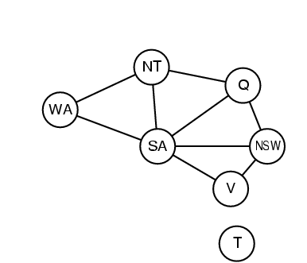
Constraint Propagation
Forward checking propagates information from assigned to unassigned variables, but doesn't provide early detection for all failures:
NT and SA cannot both be blue!
Why didn’t we detect this yet?
In forward checking, we do not detect failure until upon assignment
Constraint propagation: reason from constraint to constraint
NT
Q
WA
SA
NSW
V

Slide 21

Consistency of A Single Arc
An arc X → Y is consistent if for every x in the tail there is some y in the head which could be assigned without violating a constraint
Forward checking: Enforcing consistency of arcs pointing to each new assignment; but we want to do for non-assignments as well
NT
Q
WA
SA
NSW
V
Delete from the tail!

Slide 22
Arc Consistency of an Entire CSP
A simple form of propagation makes sure all arcs are consistent:
Important: If X loses a value, every arc pointing to it need to be rechecked!
Arc consistency detects failure earlier than forward checking
Can be run as a preprocessor or after each assignment
What’s the downside of enforcing arc consistency?
Start movie halfway through (partially assigned)
NT
Q
WA
SA
NSW
V
Remember: Delete from the tail!

Slide 23
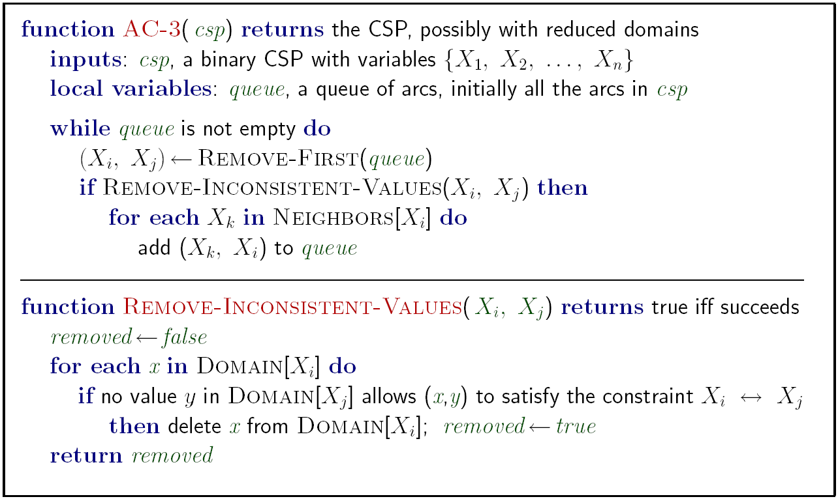
Enforcing Arc Consistency in a CSP

Slide 24

Ordering

Slide 25

Ordering: Minimum Remaining Values
Variable Ordering: Minimum remaining values (MRV):
Choose the variable with the fewest legal left values in its domain
Why min rather than max?
Also called “most constrained variable”
“Fail-fast” ordering
You have to deal with all variables
do the hard one now
Rush to the scary door

Slide 26
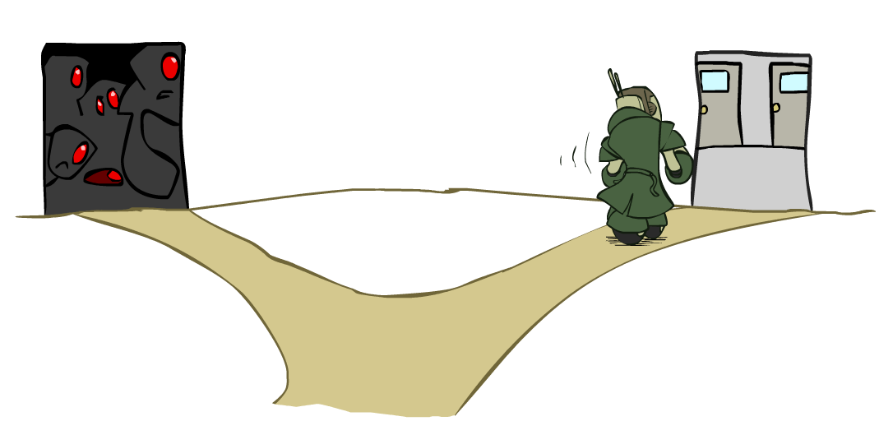
Ordering: Least Constraining Value
Allows 1 value for SA
Allows 0 value for SA
Value Ordering: Least Constraining Value
Given a choice of variable, choose the least constraining value
I.e., the one that rules out the fewest values in the remaining variables
Note that it may take some computation to determine this! (E.g., rerunning filtering)
Why least rather than most?
Pick the easy door

Slide 27

Recommended reading
Stuart Russell, Peter Norvig: Artificial Intelligence A Modern Approach
Chapter 6

Slide 28

AI Lecture 1: Module overview and introduction to sessions

